Slide 1

GROUP 1 · TEAM B · INFOSYS SPRINGBOARD VIRTUAL INTERNSHIP 7.0
CYBER THREAT ANALYTICS PLATFORM
WITH INCIDENT VISUALIZATION SYSTEM – GROUP 1
A Power BI Cybersecurity Analytics Project | Group Project Presentation
Presented By
Narayani Kantamreddy
Mentor: Mrs. Nithyasri S J | Duration: 8 Weeks
Dataset: Global Cybersecurity Threats (2015–2024) · Tool: Microsoft Power BI

Slide 2




WHERE WE STARTED
Project Objectives
1
2
ANALYZE CYBERSECURITY INCIDENTS
PREPARE QUALITY DATA
Analyze cybersecurity threat incidents and understand their impact across industries and organizations worldwide.
Collect the Global Cybersecurity Threats dataset and clean and preprocess it for meaningful analysis using Power BI.
3
4
IDENTIFY THREATS & PATTERNS
BUILD INTERACTIVE DASHBOARDS
Identify attack trends, financial losses, affected users, vulnerabilities, risk levels, and incident-resolution performance.
Transform processed cybersecurity data into interactive Power BI dashboards that support data-driven security decisions.
Cyber Threat Analytics Platform With Incident Visualization System — Group 1
2

Slide 3





WHAT WE BUILT
Project Description
The Cyber Threat Analytics Platform with Incident Visualization System is a cybersecurity analytics solution developed using Microsoft Power BI. It transforms raw cybersecurity incident data into interactive dashboards analyzing attack trends, financial impact, affected users, industry risks, country-wise incidents, vulnerabilities, defense mechanisms, and incident resolution performance.
MODULE 1 — Problem Understanding
MODULE 2 — Data Collection & Understanding
MODULE 3 — Data Preprocessing
Defined the cybersecurity analysis requirements and identified key focus areas: attacks, industries, financial loss, and vulnerabilities.
Collected and examined the Global Cybersecurity Threats (2015–2024) dataset sourced from Kaggle.
Used Power Query Editor to clean, standardize, filter, and transform the raw dataset into an analysis-ready form.
MODULE 4 — Data Modeling & DAX
MODULE 5 — Dashboard Development
MODULE 6 — Insights & Reporting
Organized the cleaned data model and created DAX measures and KPIs to support analysis and reporting.
Created interactive dashboards using KPI cards, charts, maps, matrices, treemaps, and slicers.
Analyzed cybersecurity patterns and presented meaningful, decision-ready insights through Power BI dashboards.
Cyber Threat Analytics Platform With Incident Visualization System — Group 1
3

Slide 4

PROCESS
Project Workflow
A step-by-step process converts raw cybersecurity data into meaningful, decision-ready insights.
1
2
3
4
Problem
Understanding
Data
Collection
Data
Understanding
Data
Connection
8
7
6
5
Share &
Publish Report
Data
Visualization
Data
Modeling
Data
Preprocessing
Each step ensures the data is accurate, reliable, and ready for analysis and decision-making.
Cyber Threat Analytics Platform With Incident Visualization System — Group 1
4

Slide 5







BUILDING BLOCKS
Top Visualizations / Components Used
KPI Cards
Bar Charts
Donut Charts
Line Charts
Key metrics at a glance: total financial loss, affected users, attack volume, and average resolution time.
Compares attack types side by side and ranks the most frequent and costly cyber attacks.
Shows risk-level and attack-source distributions to highlight where exposure is concentrated.
Shows year-wise attack and financial-loss trends to reveal how threats have escalated over time.
Matrix Table
Map Visualization
Interactive Slicers
Treemap
Cross-tabulates Attack Types with Risk Levels to quickly spot the highest-risk categories.
Shows the geographical distribution of cybersecurity incidents across affected countries.
Filters by Year, Country, Risk Level, and Attack Source for fast, focused exploration.
Breaks down incidents by industry with nested, size-coded tiles.
Cyber Threat Analytics Platform With Incident Visualization System — Group 1
5

Slide 6
TIMELINE
Project Execution Milestones
The project was executed through 4 major structured milestones, each reviewed by the mentor, to ensure systematic development, validation, and final submission. Dataset: Global Cybersecurity Threats (2015–2024) — Kaggle.
02 Jul 2026
09 Jul 2026
16 Jul 2026
12 Aug 2026
1
2
3
4
MILESTONE 1
MILESTONE 2
MILESTONE 3
MILESTONE 4
Project Kickoff & Dataset Preparation
Dashboard Development
Dashboard Enhancement & Validation
Final Dashboard & Submission
Project topic finalized, dataset collected from Kaggle, and data cleaning, standardization, and preprocessing completed using Power Query.
Initial Power BI dashboards developed using DAX measures, KPI cards, charts, slicers, and interactive visuals, with the data model finalized.
First five interactive dashboards completed; visuals, DAX calculations, and cross-filtering validated across all pages for accuracy.
6th (Severity & Financial Impact) and 7th (Pattern Radar) dashboards completed; all seven pages reviewed end-to-end, then the final report and PPT submitted.
8
7
3,001
12 Aug 2026
Weeks Duration
Dashboards Delivered
Records Analyzed
Final Submission
Cyber Threat Analytics Platform With Incident Visualization System — Group 1
6

Slide 7
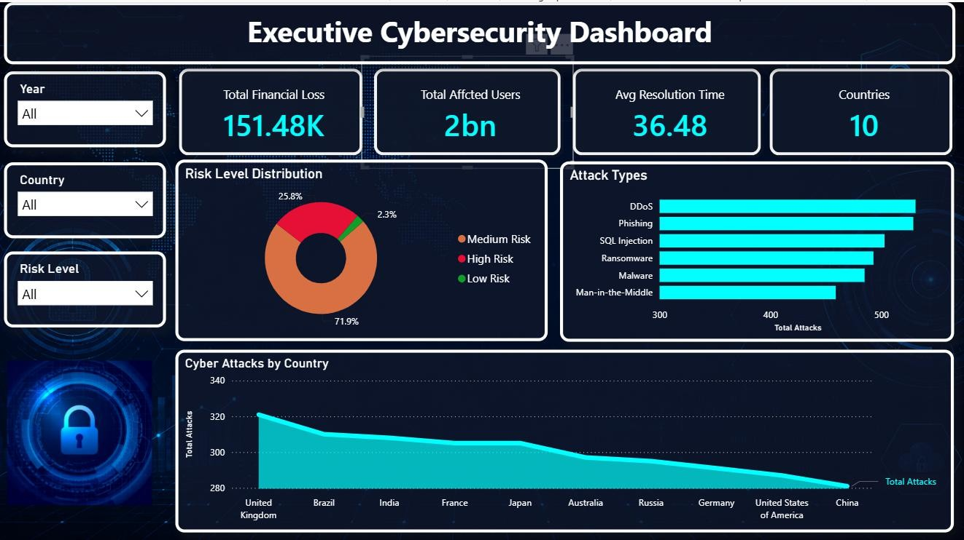
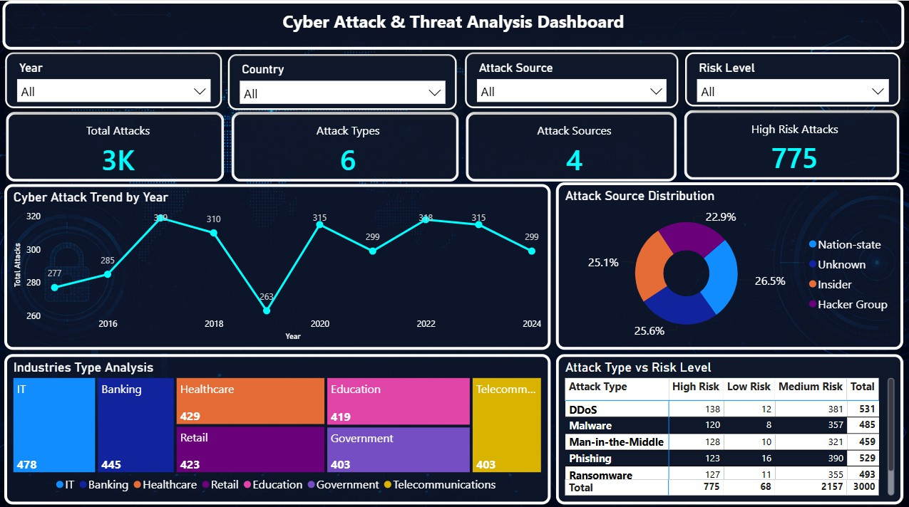
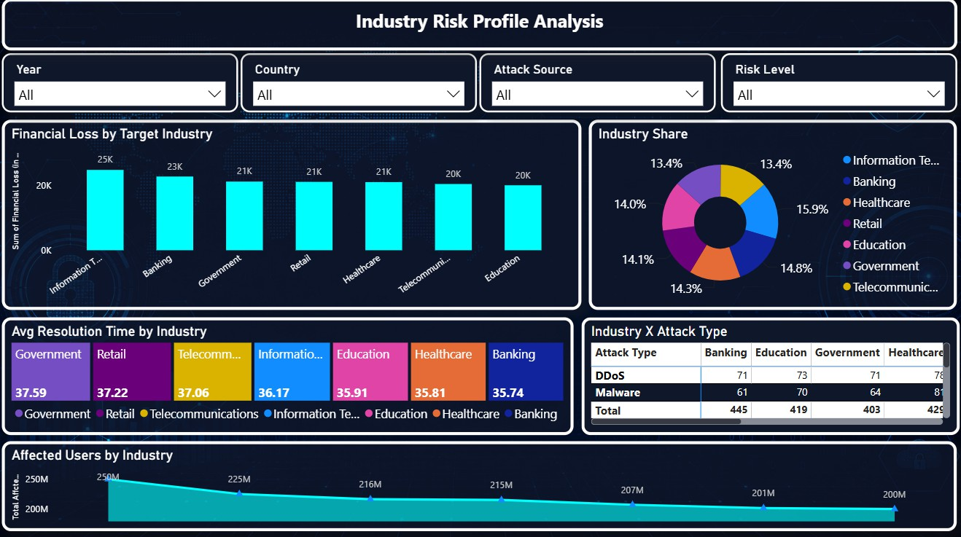
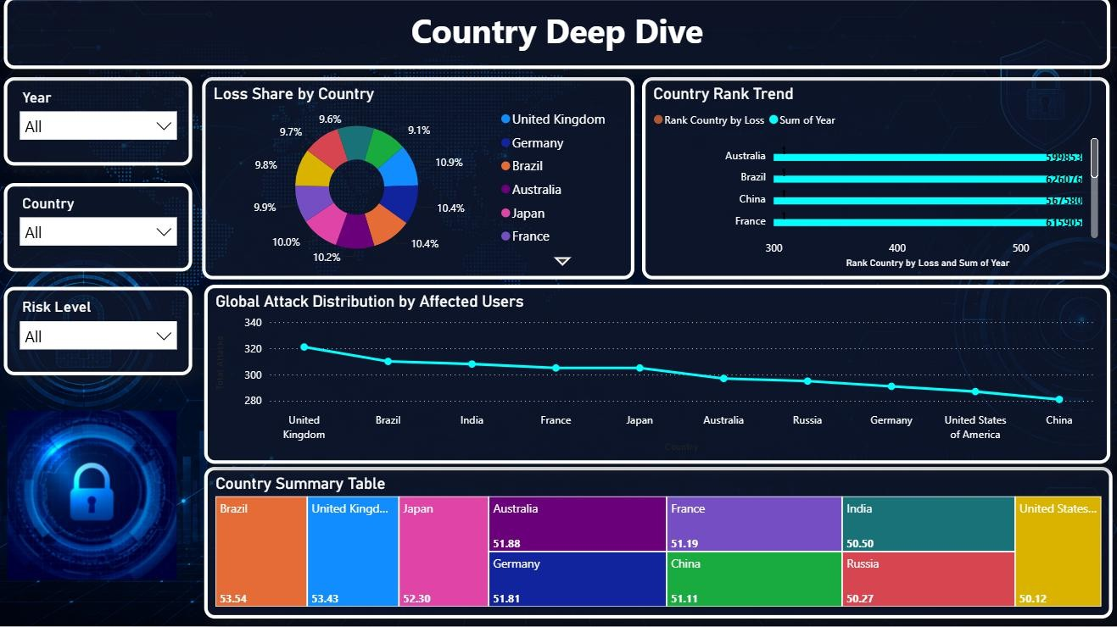
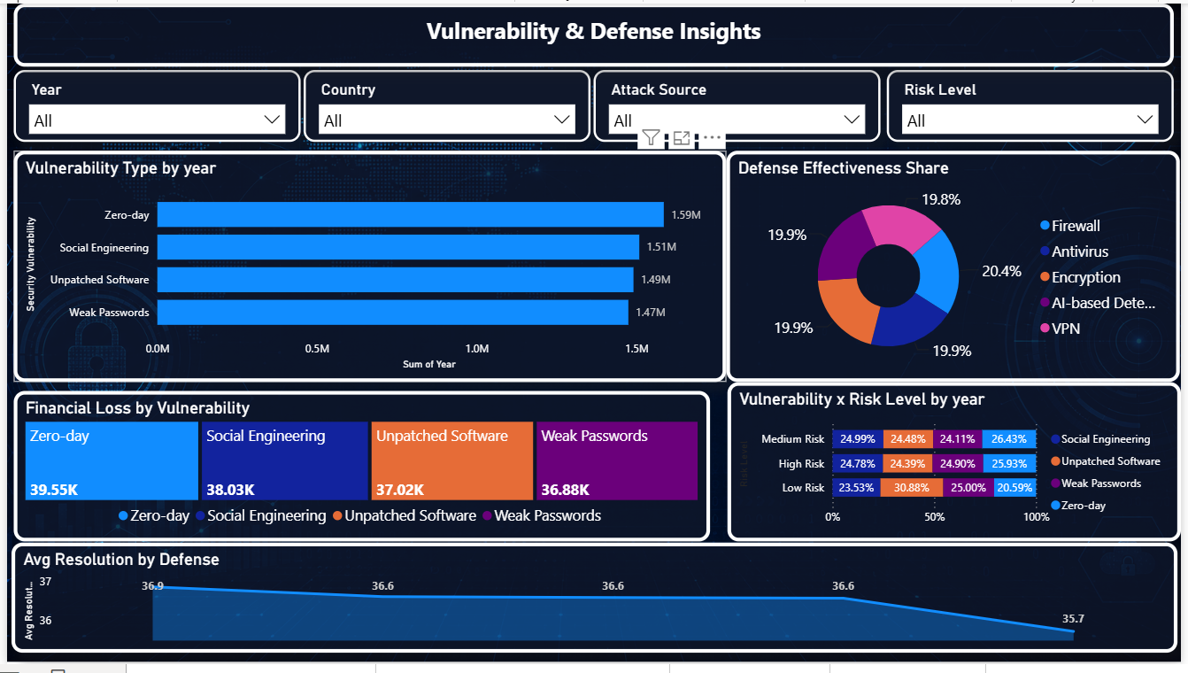
MILESTONE 3
Dashboard Development — First 5 Dashboards
Cyber Threat Analytics Platform with Incident Visualization System — Group 1
1. Executive Cybersecurity Dashboard
2. Cyber Attack & Threat Analysis
3. Industry Risk Profile Analysis
5
Interactive dashboards completed and validated in Milestone 3 — covering executive KPIs, attack & threat analysis, industry risk profiling, country-wise deep dives, and vulnerability & defense insights. Together they combine 20+ charts, maps, and matrices, all connected through shared slicers and DAX measures for real-time, cross-filtered exploration of the dataset.
4. Country Deep Dive
5. Vulnerability & Defense Insights
Each dashboard was reviewed for data accuracy, visual clarity, and drill-through interactivity before sign-off, and every KPI, chart, and slicer was cross-checked against the cleaned dataset to confirm consistent, decision-ready numbers across all five pages.
Cyber Threat Analytics Platform With Incident Visualization System — Group 1
7

Slide 8
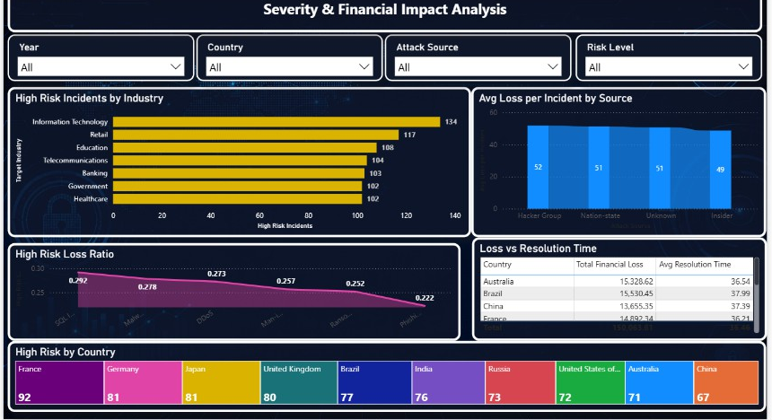
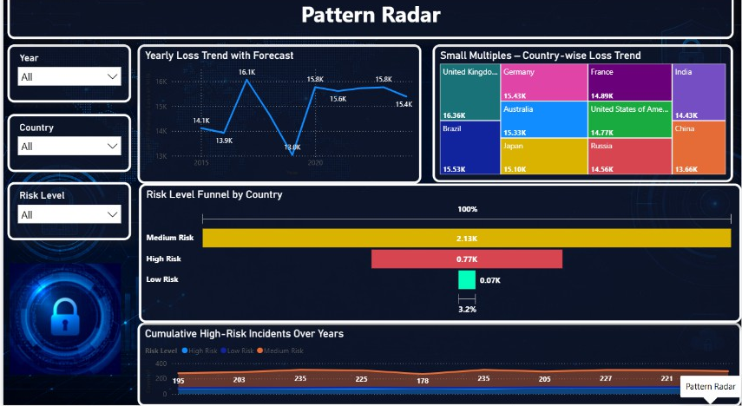
MILESTONE 4
Final Dashboards & Submission — Dashboards 6 & 7
6. Severity & Financial Impact Analysis
7. Pattern Radar
Weighs incidents by cost and risk across industries, attack sources, and countries, using severity scoring and financial-loss KPIs to surface the highest-priority threats.
Tracks loss trends with forecasting, a risk-level funnel, and cumulative high-risk incidents, revealing recurring attack patterns and how they evolve year over year.
All seven dashboards were validated end-to-end for data accuracy and visual consistency, then compiled with the final project report and presentation for submission.
Cyber Threat Analytics Platform With Incident Visualization System — Group 1
8

Slide 9
OBSTACLES WE SOLVED
Challenges Faced and Resolutions
DATA CLEANING & STANDARDIZATION
CHALLENGE
The dataset contained inconsistent values, unwanted spaces, duplicate/invalid records, and variations in country names.
RESOLUTION
Used Power Query Editor to clean the data, correct data types, trim spaces, standardize country names, and filter invalid records.
CREATING MEANINGFUL CATEGORIES
CHALLENGE
It was necessary to classify incidents into meaningful categories such as Risk Level and Resolution Speed.
RESOLUTION
Created conditional columns in Power Query using financial loss, affected users, and resolution time to classify incidents.
DESIGNING INTERACTIVE DASHBOARDS
CHALLENGE
Selecting suitable visualizations and arranging large amounts of cybersecurity information clearly was challenging.
RESOLUTION
Used appropriate Power BI visuals — bar, donut, line charts, maps, treemaps, matrices, KPI cards, and slicers — then validated and tested.
Cyber Threat Analytics Platform With Incident Visualization System — Group 1
9

Slide 10


GROWTH
Learnings & Skills Acquired
TECHNICAL SKILLS
SOFT SKILLS
Microsoft Power BI
Analytical thinking
Power Query data cleaning & transformation
Problem solving
DAX measures and KPIs
Teamwork
Data modeling
Communication
Dashboard and visualization design
Time management
Cybersecurity data analysis
Presentation and documentation
The internship provided practical experience in transforming real-world cybersecurity data into meaningful business intelligence dashboards — strengthening my technical, analytical, communication, teamwork, and problem-solving skills.
Cyber Threat Analytics Platform With Incident Visualization System — Group 1
10

Slide 11



WHAT'S NEXT
Future Enhancements
REAL-TIME CYBERSECURITY DATA
AI & MACHINE LEARNING
AUTOMATED ALERTS
ADVANCED POWER BI FEATURES
Integrate real-time security incident data for continuous monitoring.
Use predictive analytics and ML to identify potential threats and forecast risks.
Introduce automated notifications for high-risk incidents and unusual patterns.
Add role-based access, drill-through reports, and cloud deployment.
KEY INSIGHTS
1
Cybersecurity data becomes easier to understand when converted into interactive visualizations.
2
Risk, financial impact, affected users, and attack patterns should be analyzed together.
3
Interactive dashboards support faster and more informed cybersecurity decision-making.
Cyber Threat Analytics Platform With Incident Visualization System — Group 1
11

Slide 12




WRAPPING UP
Conclusion
PROJECT ACHIEVEMENT
LEARNING / TECHNICAL IMPACT
Successfully transformed ten years of global cybersecurity data into seven interactive Power BI dashboards.
Practical experience in data collection, preprocessing, Power Query, DAX, data modeling, and visualization.
INDUSTRY / PRACTICAL EXPERIENCE
OVERALL CONCLUSION
Dashboards identify attack trends, high-risk industries and countries, financial losses, and defense mechanisms.
Demonstrates how Business Intelligence and Power BI convert complex cybersecurity data into actionable insights.
Raw Data
Cleaning
Analysis
Visualization
Insights
Cyber Threat Analytics Platform With Incident Visualization System — Group 1
12

Slide 13


WITH GRATITUDE
Acknowledgements and References
ACKNOWLEDGEMENT
REFERENCES
I would like to express my heartfelt gratitude to:
1.
Global Cybersecurity Threats (2015–2024) Dataset — Kaggle
Infosys Springboard Team
2.
Microsoft Power BI Documentation
Mentor — Mrs. Nithyasri S J
My team members — Group 1, Team B
3.
Microsoft Power Query / DAX resources
Microsoft Power BI documentation and community resources
Kaggle for providing access to the cybersecurity dataset
Cyber Threat Analytics Platform With Incident Visualization System — Group 1
13

Slide 14
THANK YOU
Narayani Kantamreddy
Cyber Threat Analytics Platform With Incident Visualization System – Group 1
Infosys Springboard Virtual Internship 7.0
Cyber Threat Analytics Platform With Incident Visualization System — Group 1
14

